Slide 1

Reordering Linked Lists: Odd-Even Grouping & Every-Other Grouping
Java Implementation + Time & Space Analysis
By: Lucas Pelaez
This Photo by Unknown Author is licensed under CC BY-NC

Slide 2
Overview of Both Java Implementations
Implementation 1: Reorders list by odd-indexed nodes followed by even-indexed nodes.
Program 2: Reorders list by grouping every other node.
Both use pointer manipulation on singly linked lists.
Constant space, linear time.

Slide 3
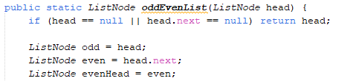
Implementation 1 - (Odd Followed by Even)
ODD starts at the first node (index 1).
EVEN starts at the second node (index 2).
EVENHEAD stores the even heads that will be connected later.

Slide 4
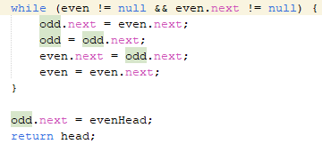
Implementation 1 - (Odd Followed by Even)
During the while loop, it is going to skip over alternating nodes to build two separate sublists.
One sublist being odd and the → other being even.
The loop keeps going until there isn’t data left to process and pair.
After the loop is processed, it takes → the odd list and pushes it to the front of the evenHead.

Slide 5
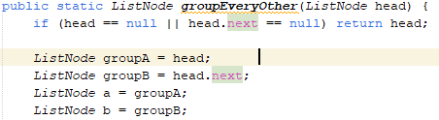
Implementation 2 - (Group Every Other Node)
groupA will hood the odd number POSITIONS not the odd NUMBERS
groupB will hold the even number POSITIONS not the even NUMBERS
As a and b are used to make these two separate links

Slide 6
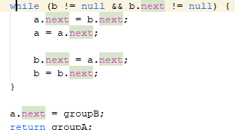
Implementation 2 - (Group Every Other Node)
Change back and forth between a and b which separates the two groups
→
The last node of a group then links to the beginning of the b group which then combines both group
→

Slide 7
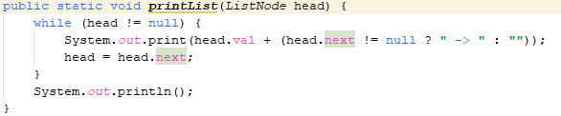
printList
Goes through each node in the list until it reaches the end (null)
If the node has a next value it add -> next to it to continue the loop but if it’s the end, then it stops.

Slide 8
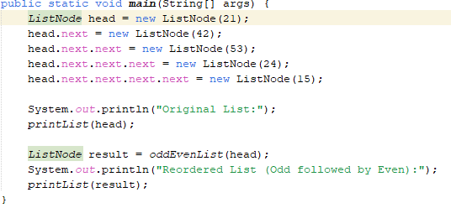

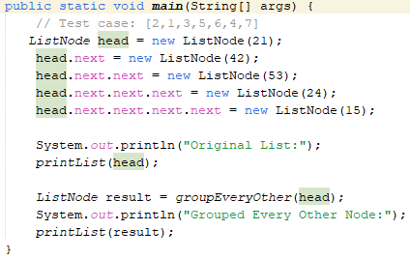

Results

Slide 9
Temporal and Spatial Complexity
Both Implementations have a O(n) time complexity.
Each Node is used once during both implementations
Inside the loop also the pointers has a constant time O(c)
Speaking on the O(c), both have a O(c) space complexity.
No extra data was used
Never was duplicated always was reordered in place

